Slide 1
Acts 2:42-27
42They devoted themselves to the apostles' teaching and to the fellowship, to the breaking of bread and to prayer.
43Everyone was filled with awe, and many wonders and miraculous signs were done by the apostles.
44All the believers were together and had everything in common.
45Selling their possessions and goods, they gave to anyone as he had need.
46Every day they continued to meet together in the temple courts. They broke bread in their homes and ate together with glad and sincere hearts,
47praising God and enjoying the favor of all the people. And the Lord added to their number daily those who were being saved.

Slide 2
Non-negotiables of church living
Acts 2: 42-47

Slide 3
A Reminder of the essentials that should characterize our church life before, during and after Covid lockdown.

Slide 4
Context (Acts 2: 1-41)
The first part of Acts 2 is the story of Pentecost.
Peter had given the first Christian evangelistic sermon.
The response to the sermon was tremendous.

Slide 5
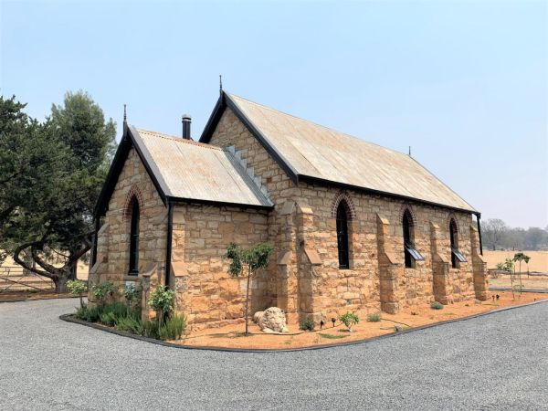
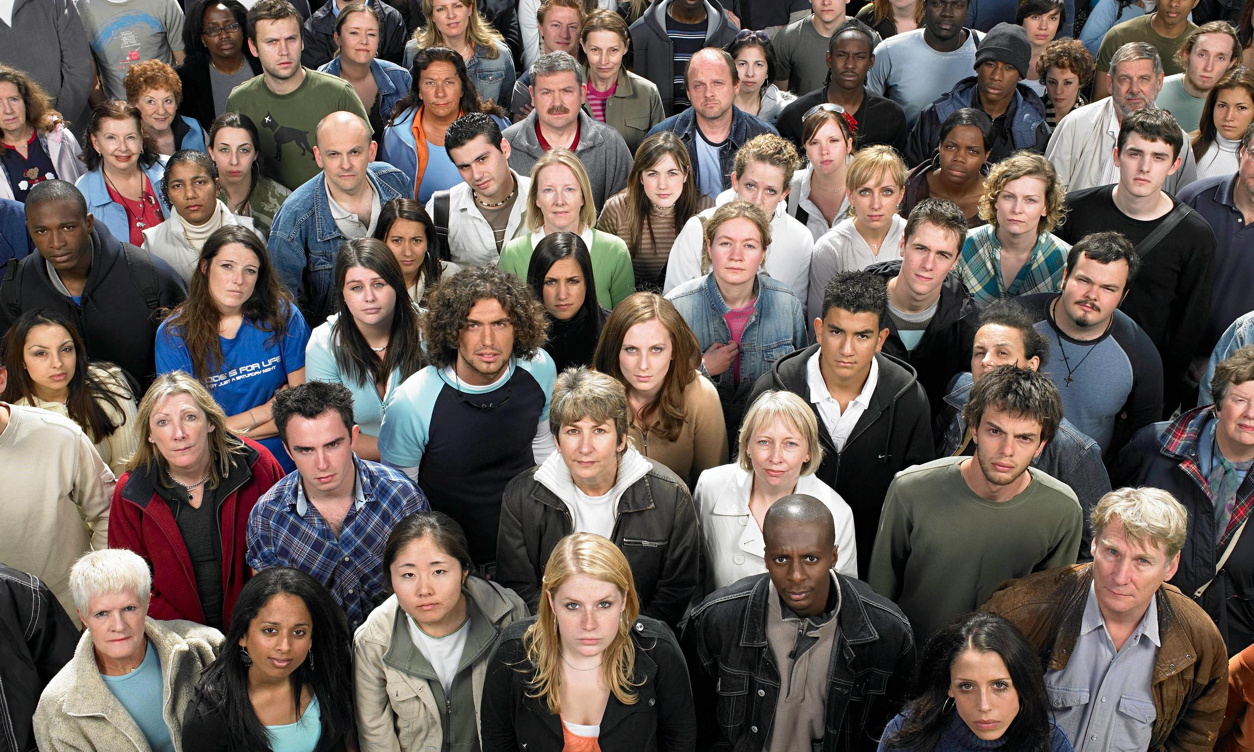
First thing to be reminded of – church is a community

Slide 6
First thing to be reminded of – church is a community
We are fundamentally a community of people.
The church building does not define who we are.
Not a structure, not an email account, not an internet platform.
We come together claiming Jesus’ promise (Matthew 18)
²⁰ For where two or three gather in my name, there am I with them.”

Slide 7
The five non-negotiables
Evangelise (vs. 47)
Exalt through worship (vs. 42)
Encourage through fellowship (vs. 42 and 44)
Edify through discipleship (vs. 42)
Equip for service (vs. 45)

Slide 8
1. Evangelise
A key feature of the church then, and now, should be that it is outward, not inward looking.
The first church understood that first and foremost it had to take the message of Jesus Christ to the world.

Slide 9
1. Evangelise
What does Rick say?
“Evangelism is more than our responsibility; it is our great privilege. We are invited to be a part of bringing people into God’s eternal family. I don’t know of a more significant cause to give one’s life to. If you knew the cure for cancer, I’m sure you’d do everything you could to get the news out. It would save millions of lives. But you already know something better: You’ve been given the gospel of eternal life to share, which is the greatest news of all!” (pp. 104-105, The Purpose Driven Church, Zondervan, 1995).

Slide 10
2. Exalt through worship
“Real prayer is expressing our devotion to our heavenly Father, inviting Him to talk to us as we talk to Him.”
Prayer is an act of devotion or worship.
Taking communion is all about remembering and celebrating Jesus’ death and resurrection
Communion is an act of devotion or worship.
Whenever we worship, we lift Him up high. This is what Exalt means.

Slide 11
2. Exalt through worship
What does Rick say?
“Throughout Scripture we’re commanded to celebrate God’s presence by magnifying the Lord and exalting His name. Psalm 34:3 (New American Standard Bible) says, ‘O magnify the Lord with me and let us exalt his name together.’ We shouldn’t worship out of duty; we should worship because we want to. We should enjoy expressing our love to God” (p. 103, The Purpose Driven Church, Zondervan, 1995).

Slide 12
3. Encourage through fellowship
The word fellowship means ‘sharing’. One of the reasons why the church exists is to fellowship, or to help one another through the sharing of material goods, and by being there to support each other morally and spiritually.
Whenever we fellowship with other believers we “Encourage” one another.

Slide 13
3. Encourage through fellowship
What does Rick say?
“As Christians we’re called to belong, not just to believe. We are not meant to live lone-ranger lives; instead, we are to belong to Christ’s family and be members of His body . . . We have each other for support. I love the way Ephesians 2:19 is phrased in the Living Bible: ‘You are members of God’s very own family . . . and you belong in God’s household with every other Christian.’ The church exists to provide fellowship for believers” (pp. 105-106, The Purpose Driven Church, Zondervan, 1995).

Slide 14
4. Edify through discipling
VERB
formal
edify (verb) · edifies (third person present) · edified (past tense) · edified (past participle) · edifying (present participle)
instruct or improve (someone) morally or intellectually.

Slide 15
4. Edify through discipling
Discipleship has something to do with teaching.
42 They devoted themselves to the apostles’ teaching
Discipleship serves to “Edify” (build up) believers.

Slide 16
4. Edify through discipleship
What does Rick say?
“As the church we are called not only to reach people, but also to teach them. After someone has made a decision for Christ, he or she must be discipled. It is the church’s responsibility to develop people to spiritual maturity. This is God’s will for every believer, Paul writes, ‘so that the body of Christ may be built up until we all reach unity in the faith and in the knowledge of the Son of God and become mature, attaining to the whole measure of the fullness of Christ’ (Ephesians 4:12b-13, NIV)” (p. 106, The Purpose Driven Church, Zondervan, 1995).

Slide 17
5. Equip for service
Service is looking beyond ourselves and our own desires in order to provide for the needs of others.
Our fifth and final “E” word is “Equip.” Jesus was the perfect example of the servant
The final non-negotiable of church life is “Equipping” believers to participate in serving others.

Slide 18
5. Equip for service
What does Rick say?
“The church exists to minister to people. Ministry is demonstrating God’s love to others by meeting their needs and healing their hurts in the name of Jesus. Each time you reach out in love to others you are ministering to them. The church is to minister to all kinds of needs: spiritual, emotional, relational, and physical” (p. 104, The Purpose Driven Church, Zondervan, 1995).

Slide 19
Wrapping up
As a church community we are to:
“evangelize” by sharing the message of salvation;
“exalt” the name of Jesus through worship;
“encourage” one another through fellowship;
“edify” the church through discipleship; and
“equip” the church to serve others.

